Slide 1
Media Account createtion and use guides

Slide 2
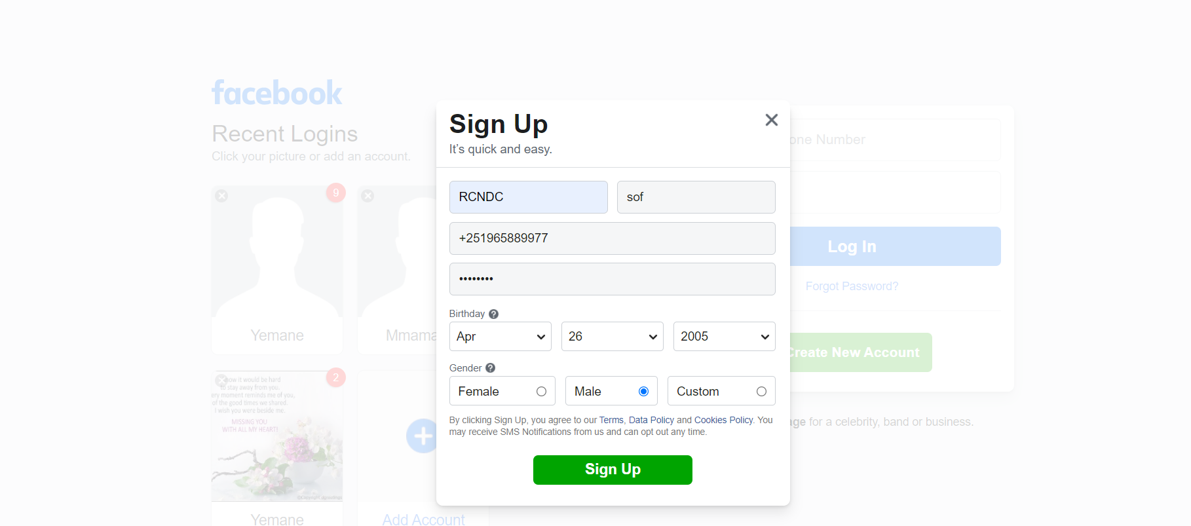
Facebook account creation and use guides
Step1:go to facebook.com and create your account using phone number

Slide 3
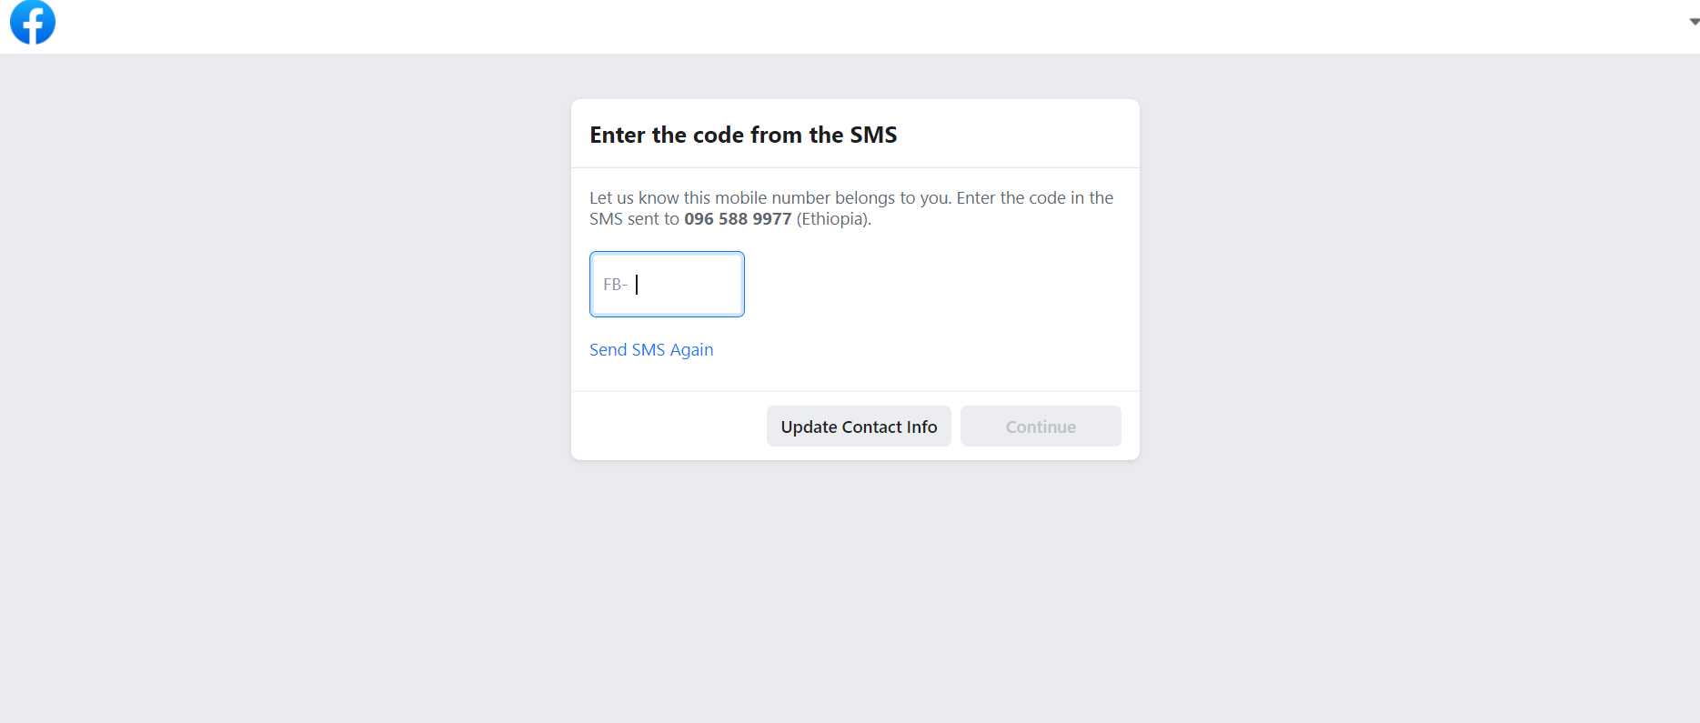
Security code is sent to your mobile number as sms and enter the code on this

Slide 4
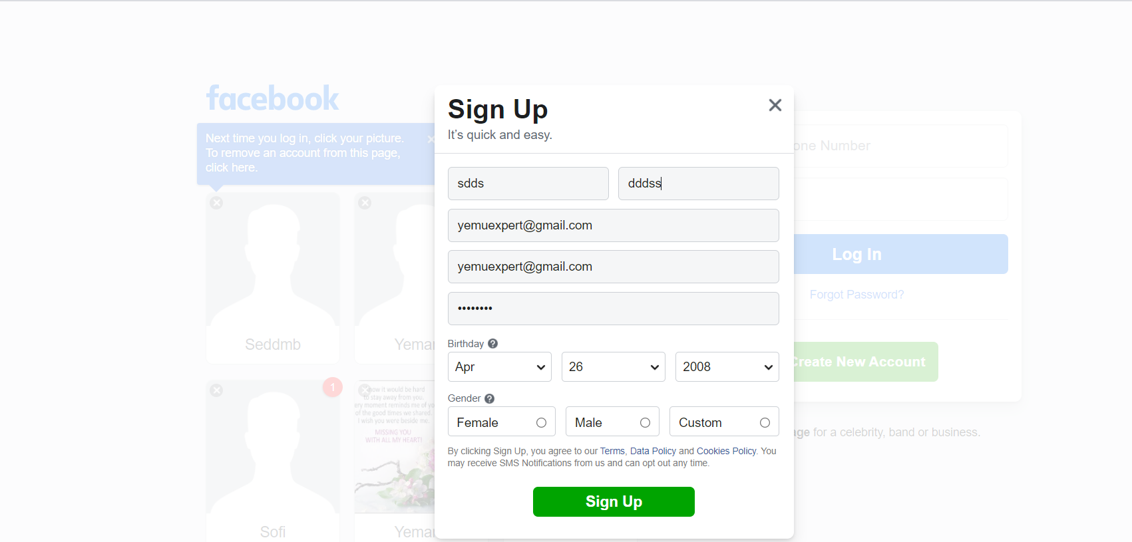
Create facebook by email:

Slide 5
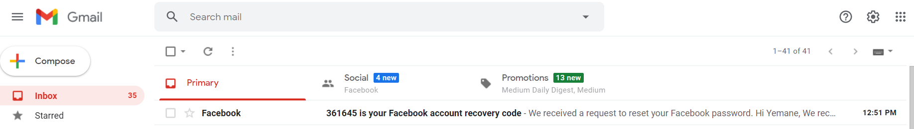
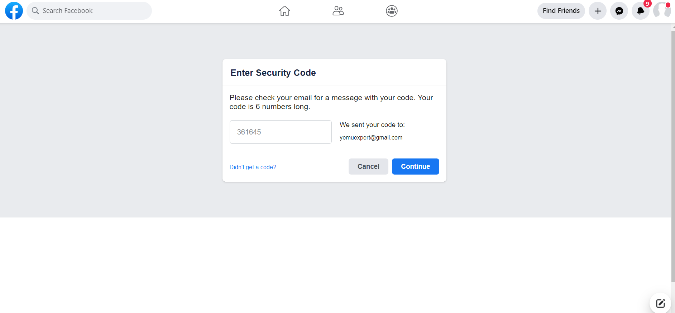
Code is sent to your gmail and enter the code to this space and click continue:

Slide 6
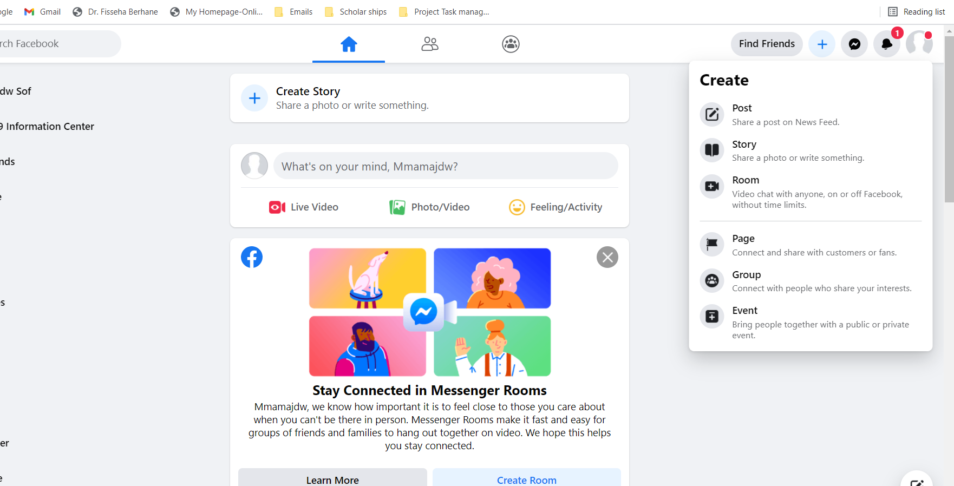
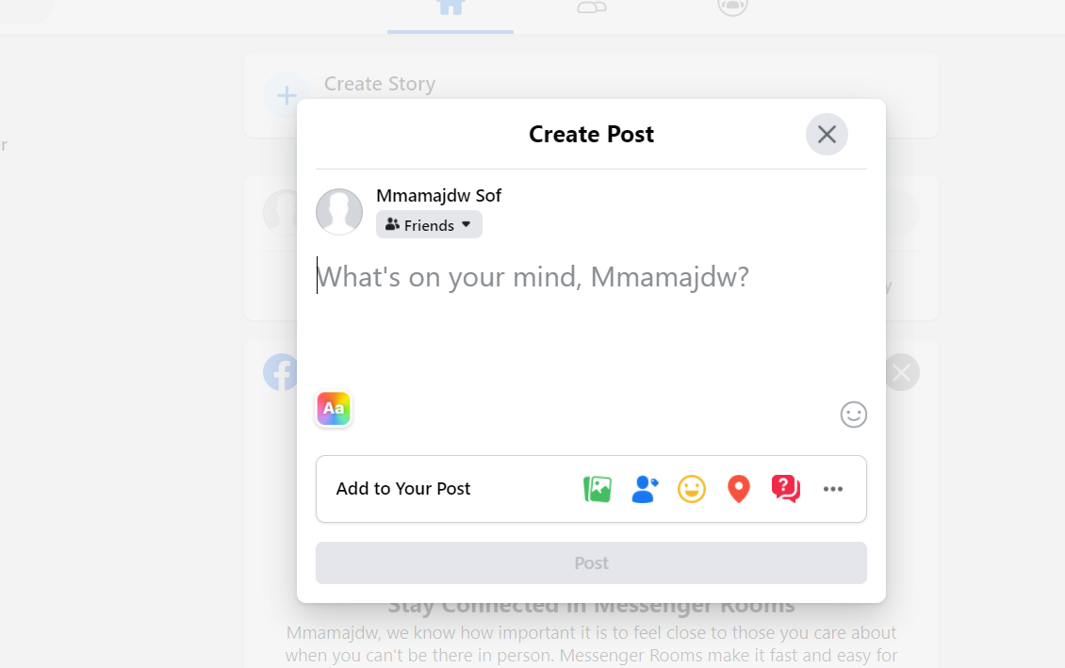
Step2:create post on fb

Slide 7
Create post on your facebook page:

Slide 8
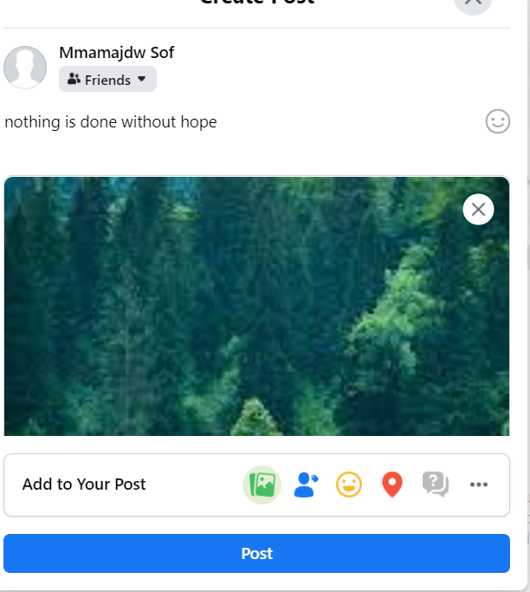

Slide 9
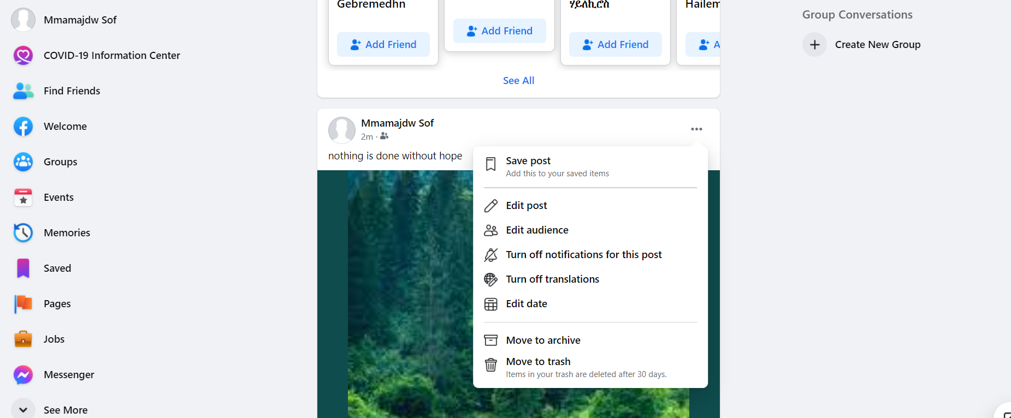
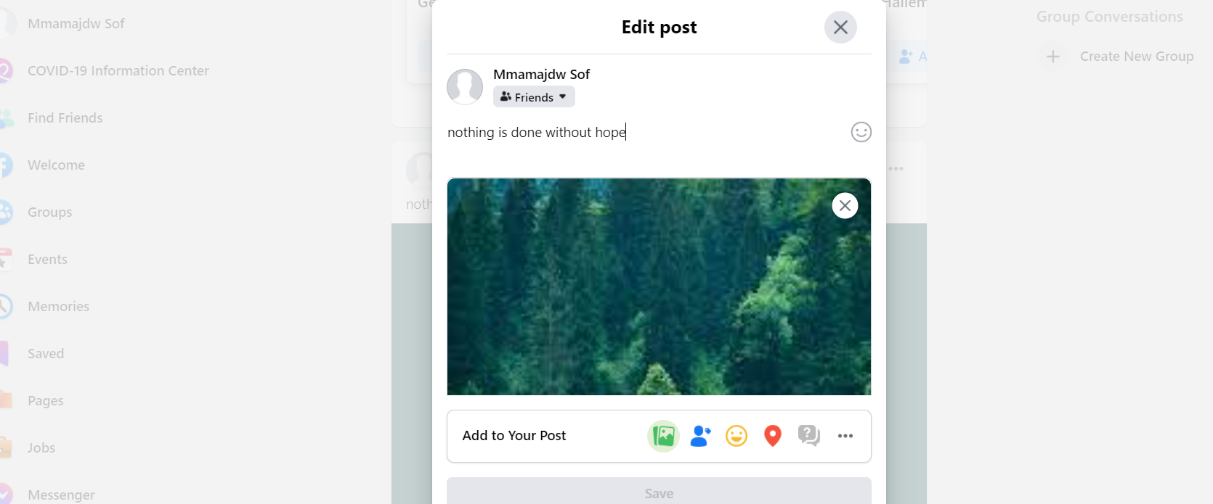
Step3:edit post

Slide 10
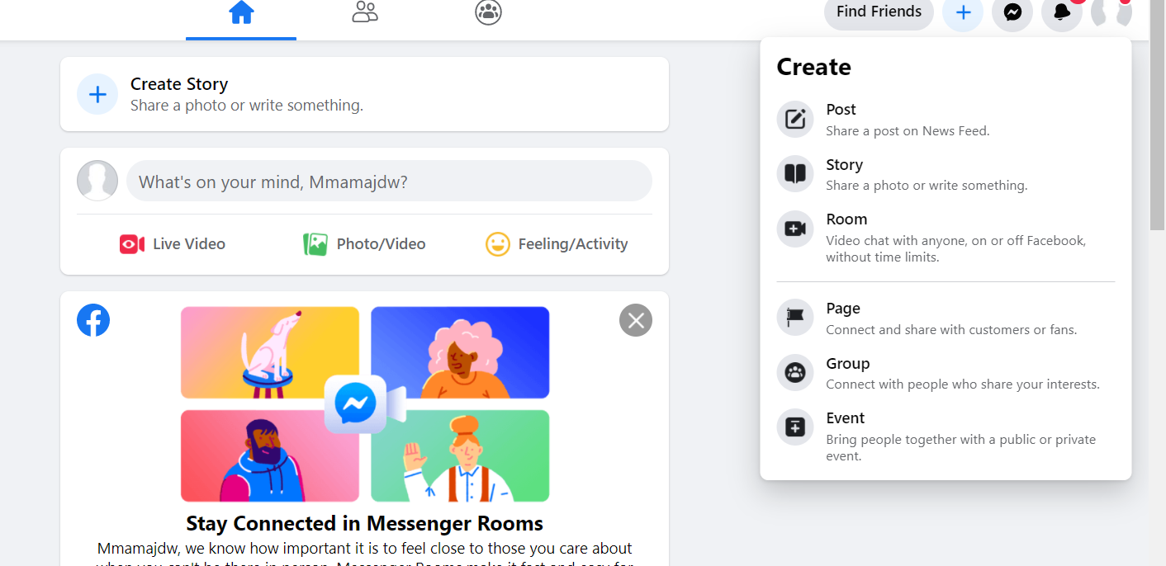
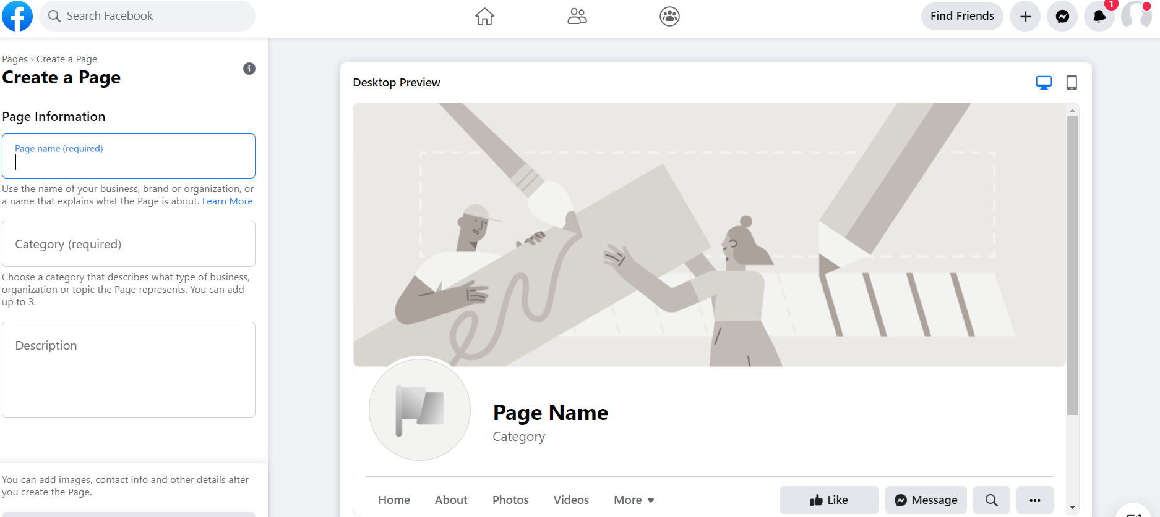
Step4:create facebook page:

Slide 11
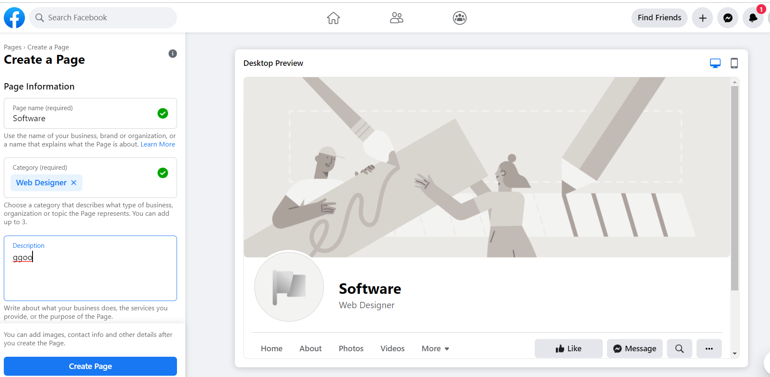

Slide 12
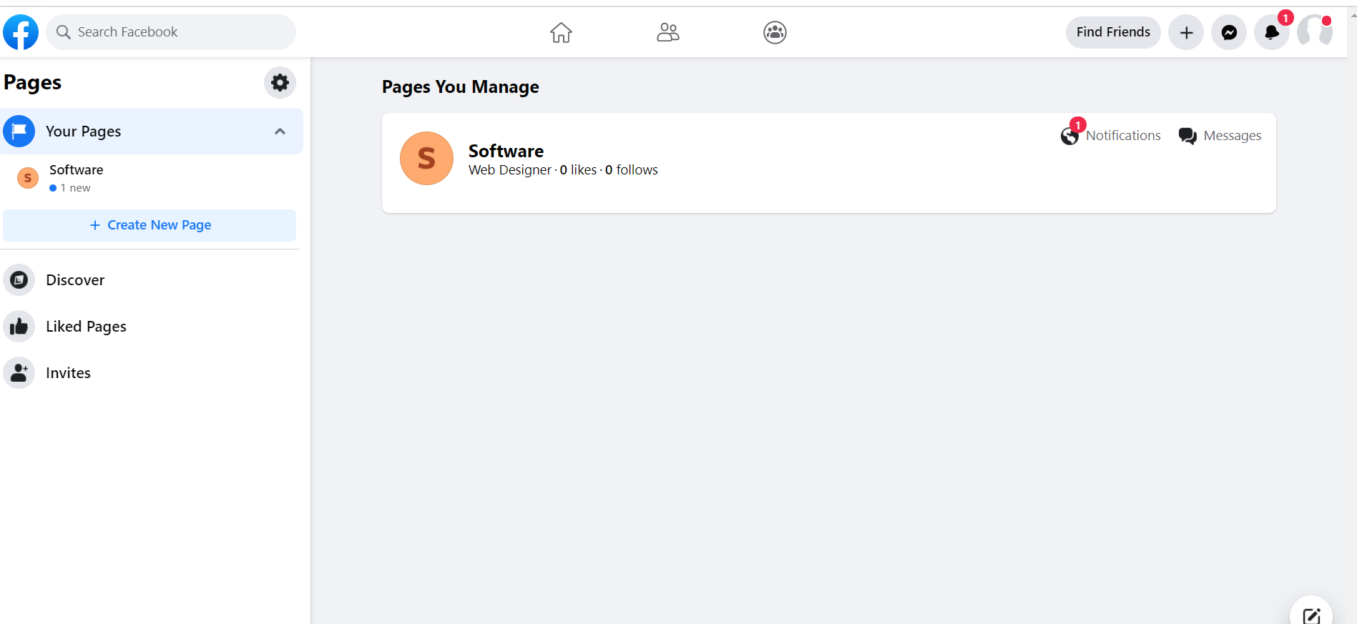
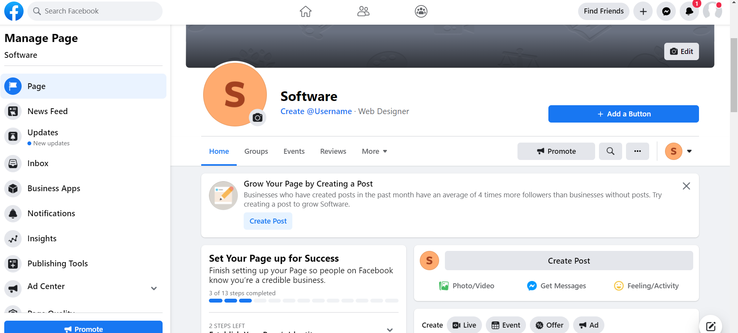
Create post on the created page

Slide 13
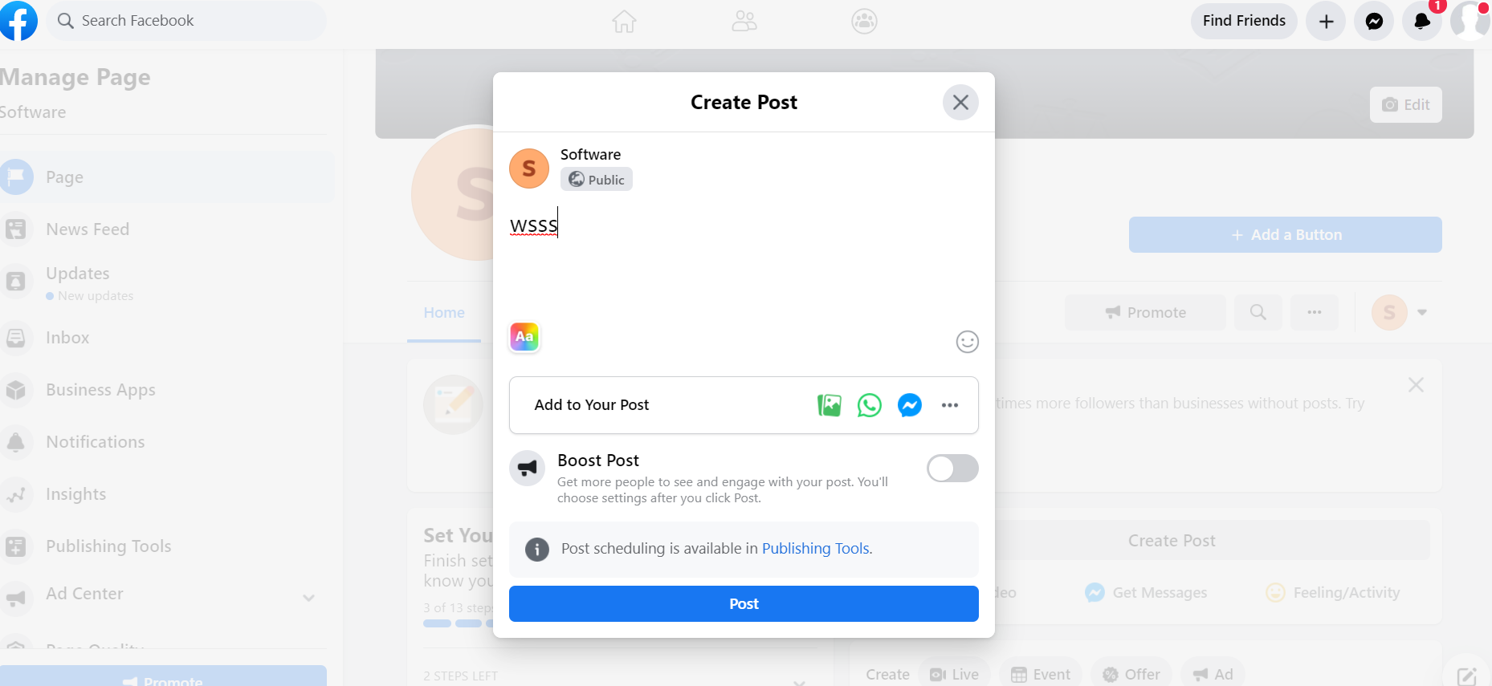

Slide 14
Editpost pages

Slide 15
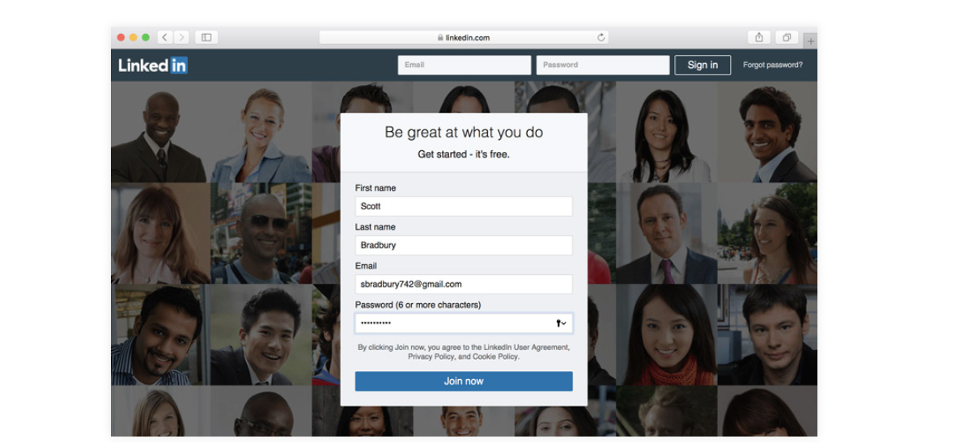
Create linked Account
Step1:
To get started, go to linkedin.com in your web browser. Enter your information, choose a password, then click the Join button. LinkedIn will guide you through the steps of adding more detail to your profile.

Slide 16
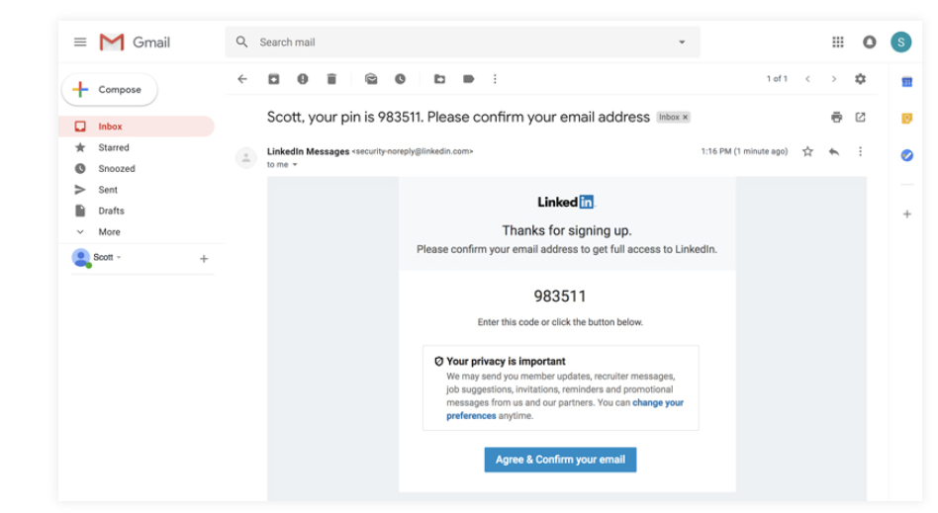
Step2:
Next, you'll need to verify your email address. Go to your email inbox, look for a message from LinkedIn, then click the confirmation button or type the PIN into LinkedIn. It may also ask for your phone number to send you another verification code, so you may want to have your phone nearby just in case.

